Slide 1
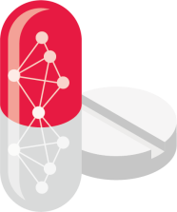
DRUG TARGET INTERACTION FOR DRUG REPURPOSING USING COMBINED DEEP NETWORK
Submitted by | Guided by
V. Vijaykanth | Dr.K.A.Vidhya ( Teaching Fellow )
2019246046 | Information Science and Technology
M.Tech – Information Technology | Anna University - CEG Campus

Slide 2
INTRODUCTION – DRUG-REPURPOSING
Drug repurposing aims to repivot an existing drug to a new therapy.
There are many factors that can be used to predict new target
i.e., protein-protein interaction,
chemical structure,
gene expression and functional genomics,
Phenotype and side effect,
genetic variation
Drug discovery is a lengthy process
taking on average 12 years for the drugs to reach the market
best way to discover a new drug is to start with the old one
using protein sequence independent training dataset
Protein sequence optimized using validation dataset

Slide 3
OBJECTIVE
drug target interaction for drug repurposing for comprehensive and easy-to-use software toolkit for dl based drug target interaction prediction with applications to drug screening and repurposing.
The unique feature of drug target interaction for drug repurposing is that it enables non-computational drug development scientists to identify drug candidates based on five pre-trained dl models with only a few lines of codes.
Despite previous research models are difficult to use in real drug discovery practice due to the complexity of deploying the research code as well as the restricted data formatting, model capacity, and evaluation setting but our model present a comprehensive and easy-to-use for Deep Learning based Drug Target Interaction prediction with applications to drug repurposing.

Slide 4
LITREATURE SURVEY
Author/Publication | Title | Method | Description
Ping Xuan, Yilin Ye, Tiangang Zhang, Lianfeng Zhao, Chang Sun July 9, 2019 | Convolutional Neural Network and Bidirectional Long Short-Term Memory-Based Method for Predicting Drug-Disease Associations | Bidirectional long short-term memory (BiLSTM), Convolutional Neural Network (CNN), Drug-Disease Network (DrDsNet) | The Path information was deeeply integrated using the BiLSTM module of this method. The prediction performance of the CBPred the experimental result revealed that CBPred Outperformned.

Slide 5
LITREATURE SURVEY
Author/Publication | Title | Method | Description
Ingoo Lee, Jongsoo keum, Hojung Nam June 14, 2019 | DeepConv-DTI : Prediction of Drug-target interactions via deep learning with convolution on protein sequences | Matrix factorization, Docking Method, Stacked Auto Encoder(SAE), Deep Brief Network (DBN), Convolutional Neural Network (CNN). | The identification of Drug Target Interactions in large-scale or chemical experiments using this method we can predict the drug disease association and predict the local residue method. fingerprint is mostly commonly used descriptive of the substructure of the drug. All the processing is depends on the omics data processing.

Slide 6
PROPOSED SYSTEM
TOPIC : DRUG TARGET INTERACTION FOR DRUG REPURPOSING USING COMBINED DEEP NETWORK
PROBLEM STATEMENT : drug target interaction for drug repurposing to comprehensive and easy-to-use software toolkit for deep learning based drug target interaction prediction with applications to drug screening and repurposing. It is based on the collection of existing information on neural networks.It also significantly reduces waste and pollution because it reduces the need for raw materials.

Slide 7
MODULES
MODULE – 1 : Training Dataset Generation .
MODULE – 2 : Targets fed into a decoder to predict DTI binding.
MODULE – 3 : Improve The Sequence Interaction Level.
MODULE – 4 : New DTI Prediction Using Independent Dataset.
MODULE – 5 : Interaction between the Drug Target sequence.
MODULE – 6 : Finding a Novel drug from an Exiting Approved drug’s.
MODULE – 7 : Repurposing using Customized training data with probability.
MODULE – 8 : Generate ranked lists for repurposing and screening.

Slide 8
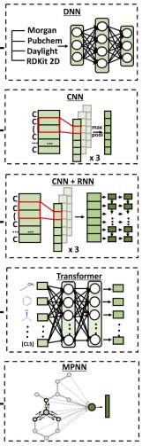
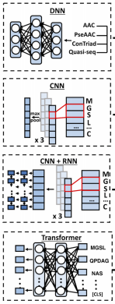
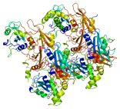

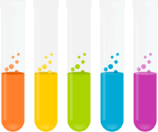
BLOCK DIAGRAM
DNN
+
DNN
TRANSFORMER
CNN + RNN
MPNN
TRANSFORMER
CNN
CNN
CNN + RNN
Amino Acid Sequence
Target Sequence
DRUG TARGET INTERACTION FOR DRUG REPURPOSING USING COMBINED DEEP NETWORK
Repurposing using Customized training data

Slide 9
CNN
CNN(Convolutional Neural Network) can be used to encode both drug and protein on SMILES. The larger K_{D} value, the more weakly target molecule and ligand are attracted to bind to one another.
class DeepPurpose.models.CNN(nn.Sequential)
Init (self, encoding, **config) : encoding (string, “drug” or “protein”) - specify input type of model, “drug” or “protein”.config (kwargs, keyword arguments) - specify the parameter of CNN.
forward(self, v) : v (torch.Tensor) - input feature of CNN.

Slide 10
CNN+RNN
CNN_RNN means a GRU/LSTM on top of a CNN on SMILES.
class DeepPurpose.models.CNN_RNN(nn.Sequential)
init (self, encoding, **config) : encoding (string, “drug” or “protein”) - specify input type, “drug” or “protein”.config (kwargs, keyword arguments) - specify the parameter of transformer.
forward(self, v) : v (torch.Tensor) - input feature of CNN_RNN.

Slide 11
MPNN
Message Passing Neural Network (MPNN) encode drug in its graph representation.
class DeepPurpose.models.MPNN(nn.Sequential)
nit (self, mpnn_hidden_size, mpnn_depth) : mpnn_hidden_size (int) - specify dimension of hidden layer in MPNN, e.g, mpnn_hidden_size = 256. mpnn_depth (int) - specify depth of MPNN, e.g., mpnn_depth = 3.
forward(self, feature) : feature[0] (torch.Tensor) - atom-level feature bond-level feature, neighbor information of every atom, neighbor information of every bond store number of atoms and bonds for each molecule in a batch

Slide 12
Transformer
Transformr can be used to encode both drug and protein on SMILES.
DeepPurpose.models.transformer(nn.Sequential)
init self, encoding, **config) : encoding (string, “drug” or “protein”) - specify input type of the model, “drug” or “protein”. config (kwargs, keyword arguments) - specify the parameter of transformer.
forward(self, v) : v (tuple of length 2) - input feature of transformer. v[0] (np.array) is index of atoms. v[1] (np.array) is the corresponding mask.

Slide 13
Binding Score
Binding : The Binding Score is the Kd values. Binding affinity is the strength of the binding interaction between a single bimolecular (e.g. protein or DNA) to its ligand/binding partner (e.g. drug or inhibitor).
The larger K_{D} value, the more weakly target molecule and ligand are attracted to bind
to one another.
Measured by the equilibrium dissociation constant (K_{D}), which is used to evaluate and rank order strengths of bimolecular interactions.

Slide 14
Repurpose
from DeepPurpose import oneliner
from DeepPurpose.dataset import * oneliner.repurpose(*load_SARS_CoV2_Protease_3CL(),
*load_antiviral_drugs(no_cid = True))
def load_SARS_CoV2_Protease_3CL():
target = 'SGFRKMAFPSGKVEGCMVQVTCGTTTLNGLWLDDVVYCPRHVICTSEMLNPNYEDLLIRKSNHNLYAAVINGDRWFLNRFTTTLNDFNLVAMKYNYEPLTQDHVDILGPLSAQTGIAVLDMCASLKELLQNGMNGRTILGSALLEDEFTPFDVVRQCSGVTF'
target_name = 'SARS-CoV2 3CL Protease'
return target, target_name.

Slide 15
Load Antiviral Drugs
def load_antiviral_drugs(path = './data', no_cid = False):
url = 'https://dataverse.harvard.edu/api/access/datafile/4159652'
if not os.path.exists(path):
os.makedirs(path)
download_path = os.path.join(path, 'antiviral_drugs.tab')
download_url(url, download_path)
df = pd.read_csv(download_path, sep = '\t')
if no_cid:
return df.SMILES.values, df[' Name'].values
else:
return df.SMILES.values, df[' Name'].values, df['Pubchem CID'].values

Slide 16
PLATFORM / TOOL
PY SCRIPT
PYCHARM
ANACONDA 3
JUPYTER
COLAB
DEEP LEARNING PACKAGES

Slide 17
DATASET
The MATADOR database1 is a free online database of DPIs, which includes interaction patterns between chemicals and proteins (Gunther et al., 2008).
Predicted negative Drug Target Interaction validation dataset
Drug Target Interaction available dataset – Databases
DrugBank
DAVIS
KIBA
KEGG
IUPHAR
SMILES STRING

Slide 18
REFERENCES
Keizer used chemical two-dimensional (2D) structural Frontiers in Bioengineering and Biotechnology | www.frontiersin.org 1 April 2020 | Volume 8 | Article 330 Wang et al. DLS for Predicting Drug-Protein Interactions similarity to predict new targets for known drugs and confirmed that five of the 23 new drug target associations were valid (Keiser et al., 2009)..
DTI predictions based on similarities between protein sequences or drug structures have limitations since its underlying assumption that similar drugs share similar targets is not necessarily true (Ding et al., 2014).
DPI can be expressed in the form of bipartite network, with drugs and proteins forming two disjoint sets of nodes and the interactions between the drugs and proteins forming the edges (Chen et al., 2018; Wu et al., 2018; Ma et al., 2019).
Lee proposed a method for drug repositioning using integrated networks to achieve excellent performance (Lee and Yoon, 2018).
Zhang proposed an inference method based on network topology similarity to predict unobserved drug-disease associations (?BR42). Cheng proposed a network-based inference (NBI) method that used only the binary similarity of the target’s topological network to infer novel proteins for known drugs (?BR8). Zhang proposed a network link inference method based on linear neighborhood similarity to predict miRNA-disease associations (Zhang et al., 2019b).

Slide 19
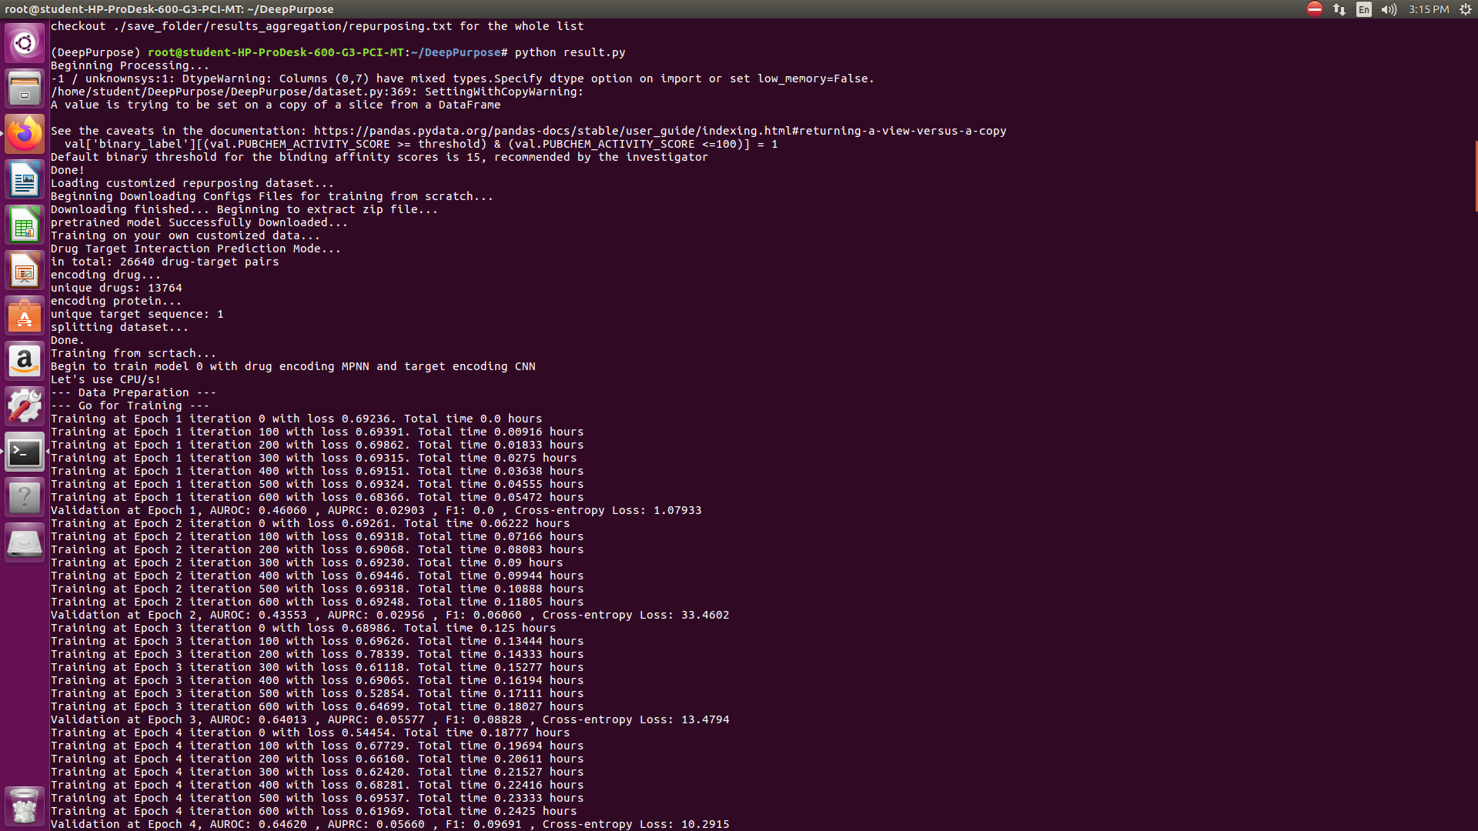
Drug Encoding MPNN and Target Encoding CNN

Slide 20
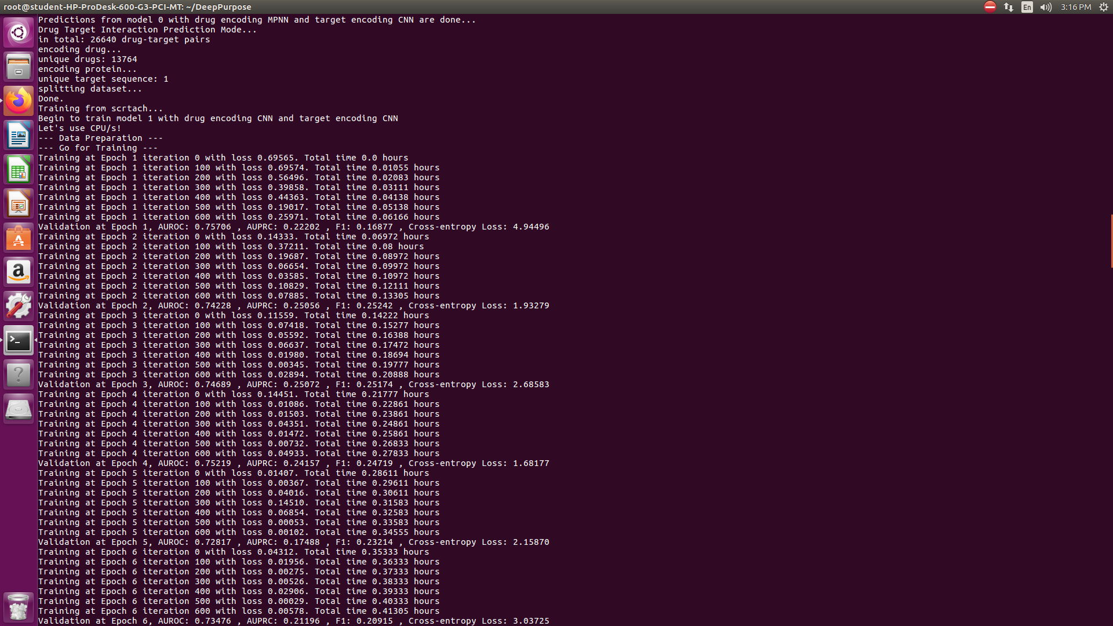
Drug Encoding CNN and Target Encoding CNN

Slide 21
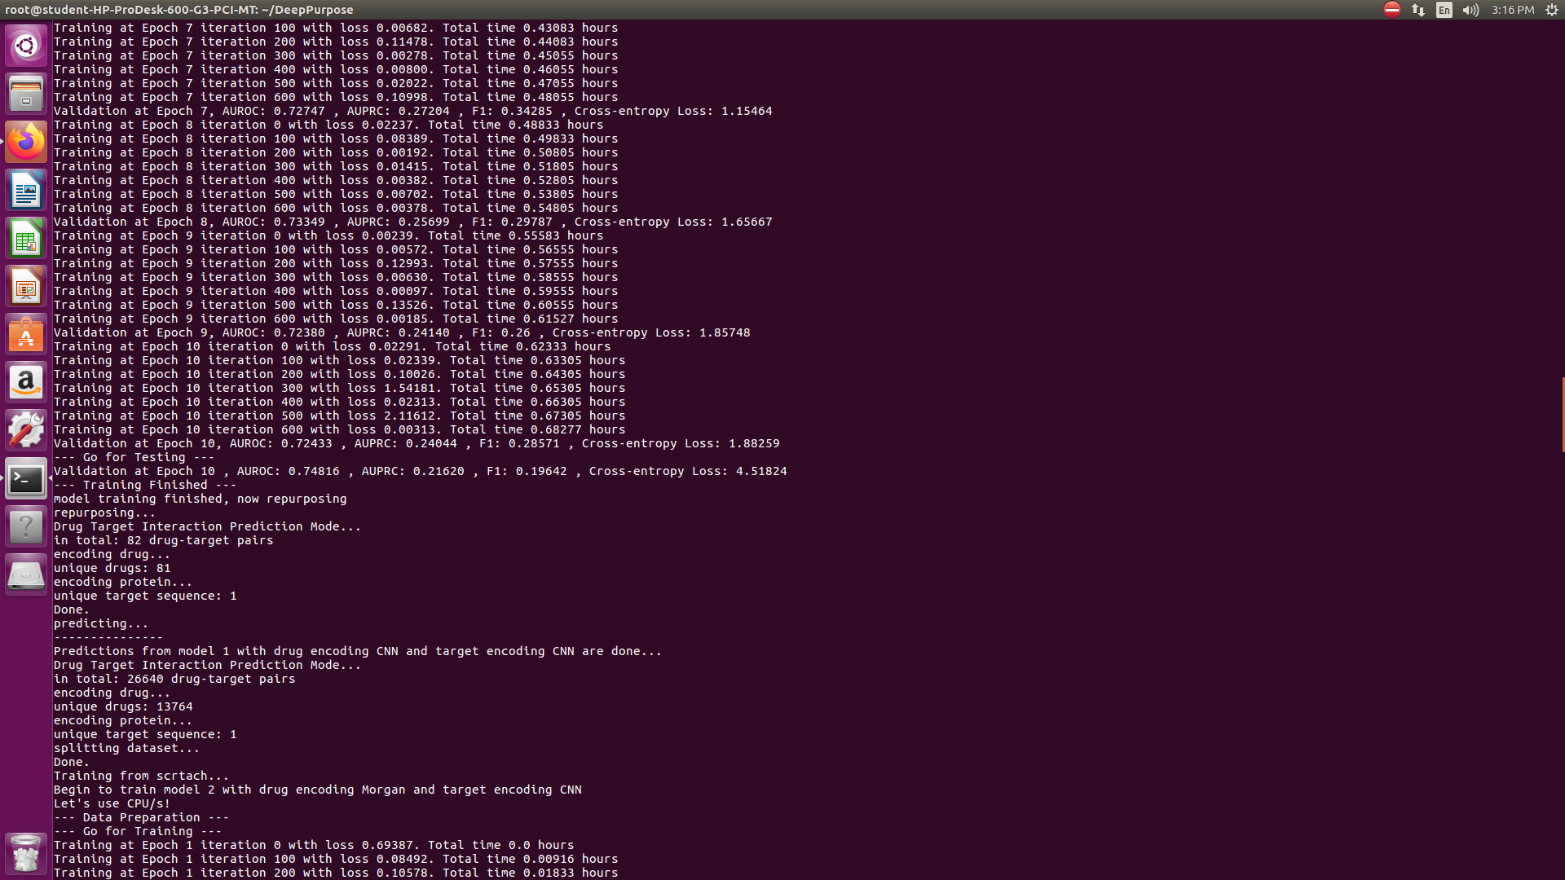
Drug Encoding Morgan and Target Encoding CNN

Slide 22
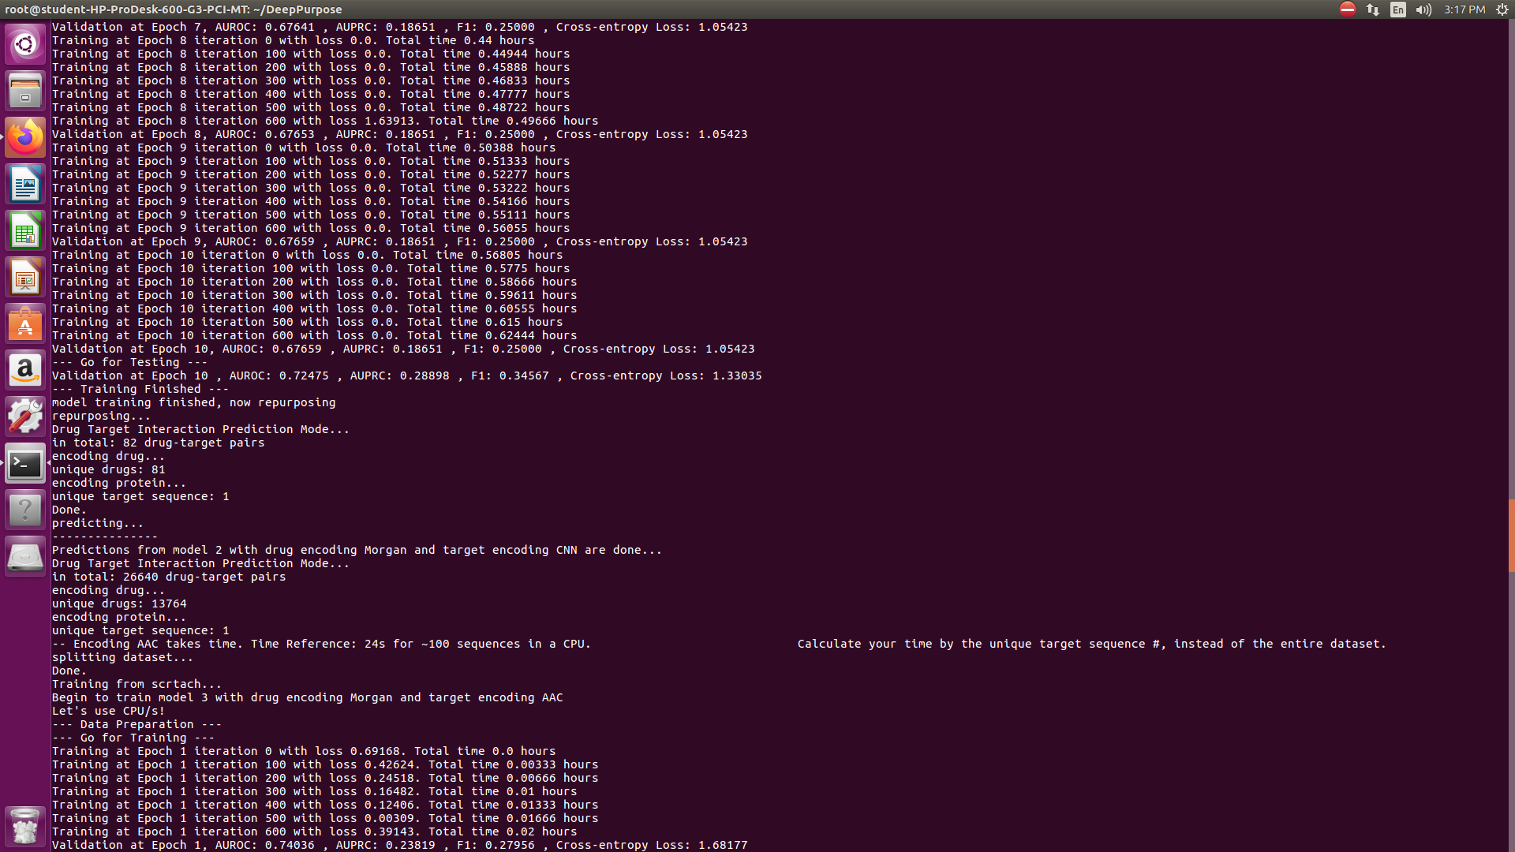
Drug Encoding Morgan and Target Encoding AAC

Slide 23
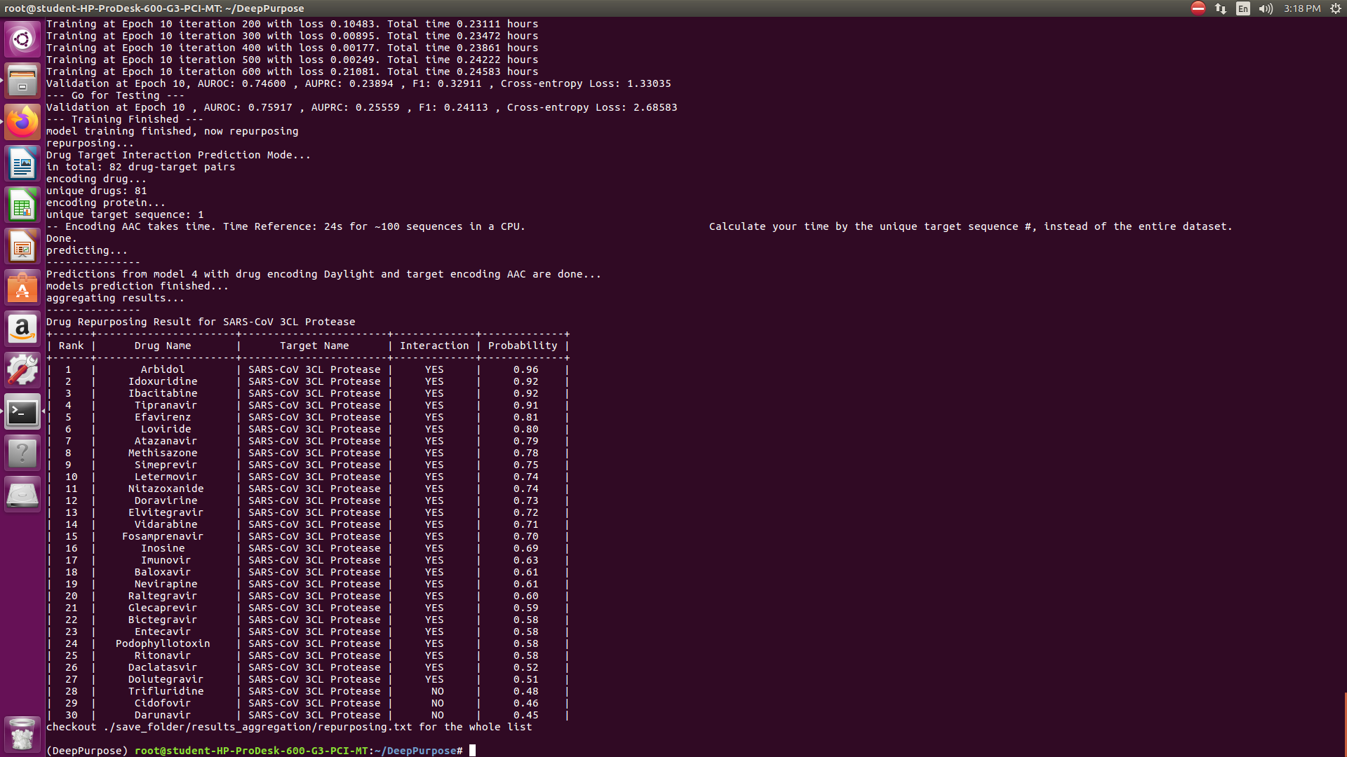
OUTPUT

Slide 24
THANK YOU

